Slide 1
Project
Debit and credit analysis
Group 06
Team members
Syed Sohaib
Shreyash Gawankar
Mathew R
Pulivarthi srikanth

Slide 2
Overview
Objective: To unify the datasets (Credit, Debit, Loan) and transform raw data into actionable insights through dynamic, interactive dashboards for key stakeholders.
Scope of Work:
  Data Consolidation and Cleaning.
  SQL-based KPI Calculation and Data Modeling.
  Development of 6 Dashboards (2 each in Excel, Power BI, and Tableau).
  Analysis of Risk, Performance, and Customer Behavior.

Slide 3
Bank debit and credit dashboard KPI description
Bank Debit and Credit Dashboard KPI Description
1-Total Credit Amount:
2-Total Debit Amount:
3-Credit to Debit Ratio:
4-Net Transaction Amount:
5-Account Activity Ratio:
6-Transactions per Day/Week/Month:
7-Total Transaction Amount by Branch:
8-Transaction Volume by Bank:
9-Transaction Method Distribution:
11-High-Risk Transaction Flag:
12-Suspicious Transaction Frequency:

Slide 4
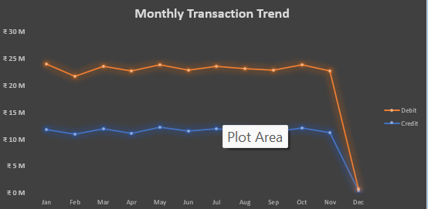
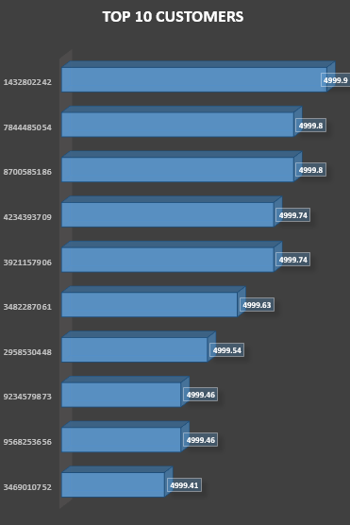
1.The chart displays two distinct lines, one for debit transactions and one for credit transactions, enabling a direct comparison across each month.
2.Debit transactions consistently remain higher than credit transactions throughout the year, indicating higher outgoing payments compared to incoming credits.
3 Both debit and credit lines show minor fluctuations from January to November, with only slight variations month-to-month.
1.This visualization highlights the top 10 customers by transaction value, illustrating who are the most important contributors to total transaction volume.
2.The horizontal bar chart format ensures clear, straightforward comparison between different customers.
3.Each customer is uniquely identified by their customer ID, and the transaction value is displayed at the end of each bar for easy reference.

Slide 5
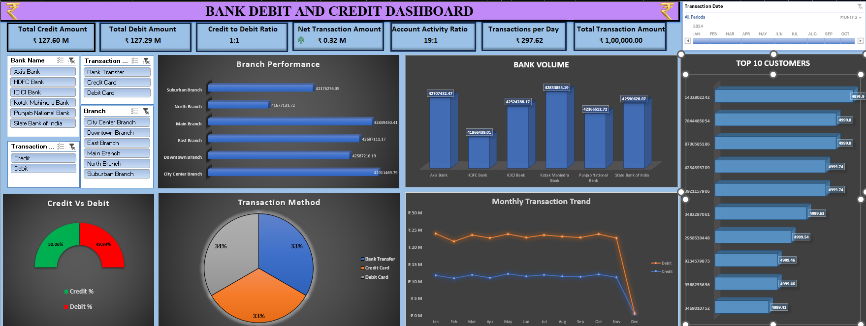
Excel dashboard

Slide 6
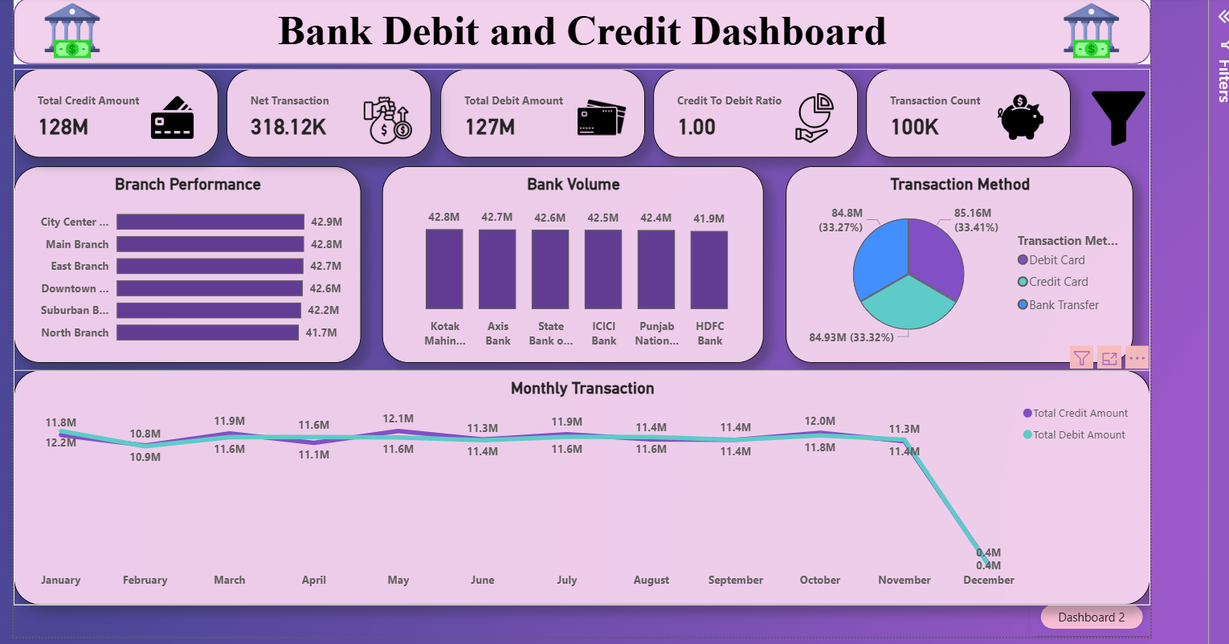
Power BI Dashboard (Credit and Debit)

Slide 7
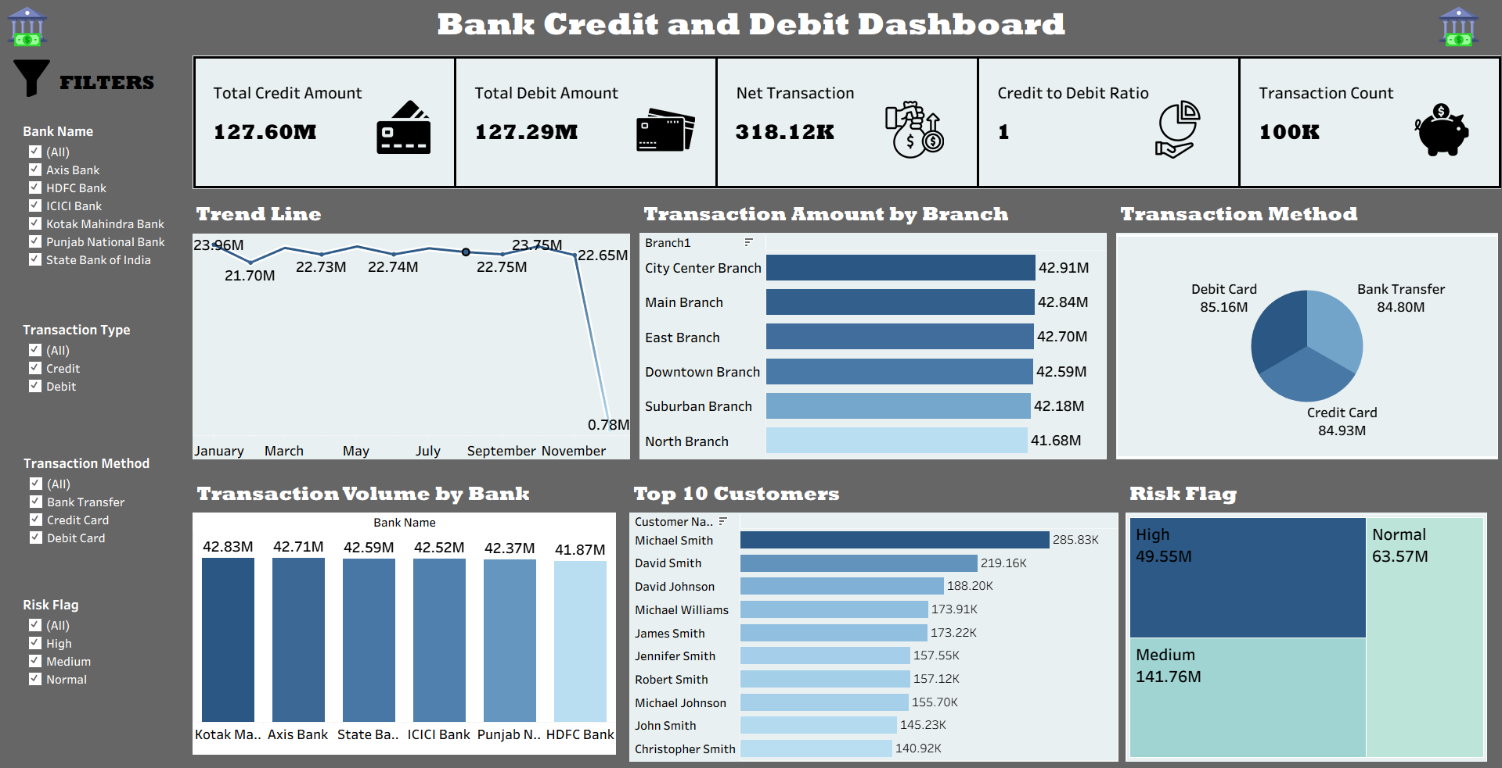
Tableau Dashboard (Credit and Debit)

Slide 8
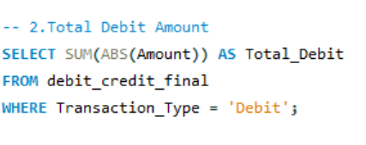
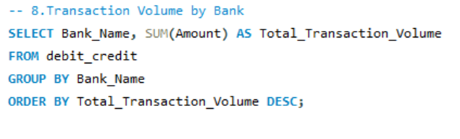
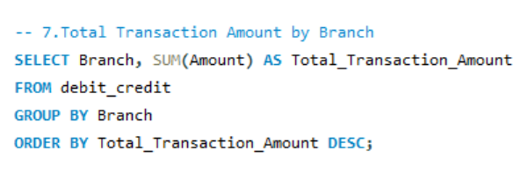
SQL QUERYS
This QUERY is total debit amount sum of total amount and in transaction type where only Debit
2.Sum of the Amount column grouped by Bank Name. compare the performance of different banks in terms of transaction activity.
1.helping to compare branch performance.
Transaction
2. Sum all branch wise amount it is easy to identify all branch wise performance and we can find highest and lowest performing branches

